Slide 1

Saudi Arabia Used Car
data of used cars advertised on syarah.com

Slide 2
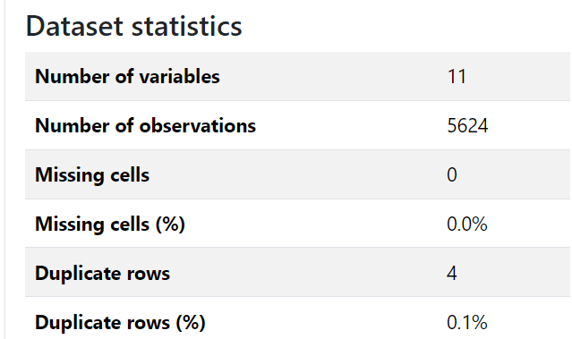
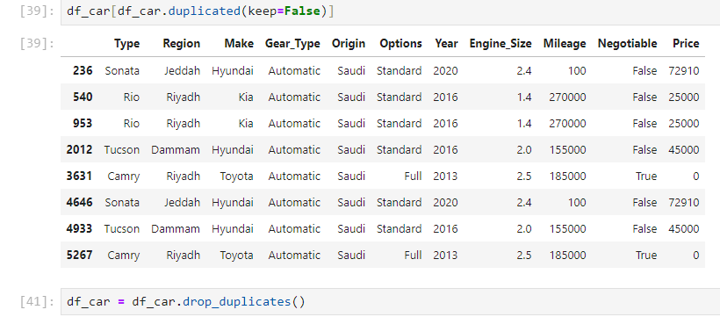
Data Quality
Remove duplicated

Slide 3
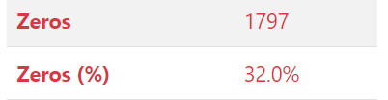

Data Quality
Price :
Exclude 0 :

Slide 4
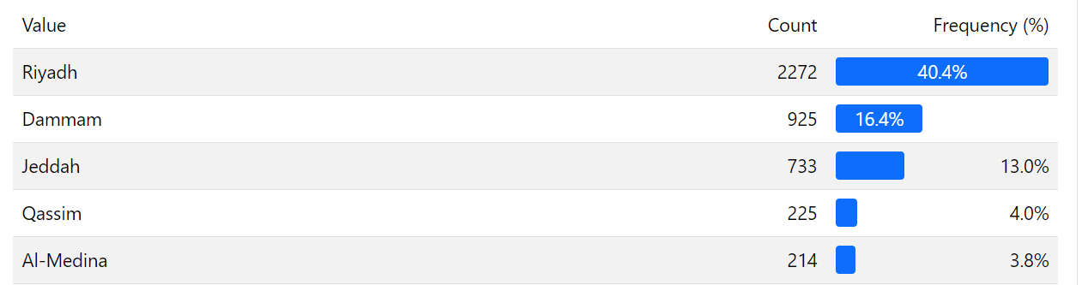
The largest Markets in Used cars

Slide 5
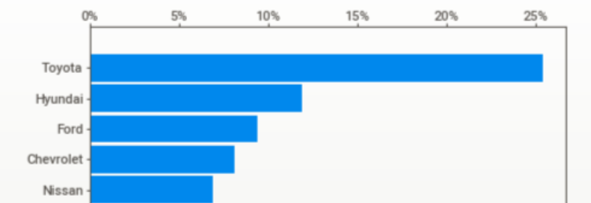
Most Brands listed for Sales 2023

Slide 6
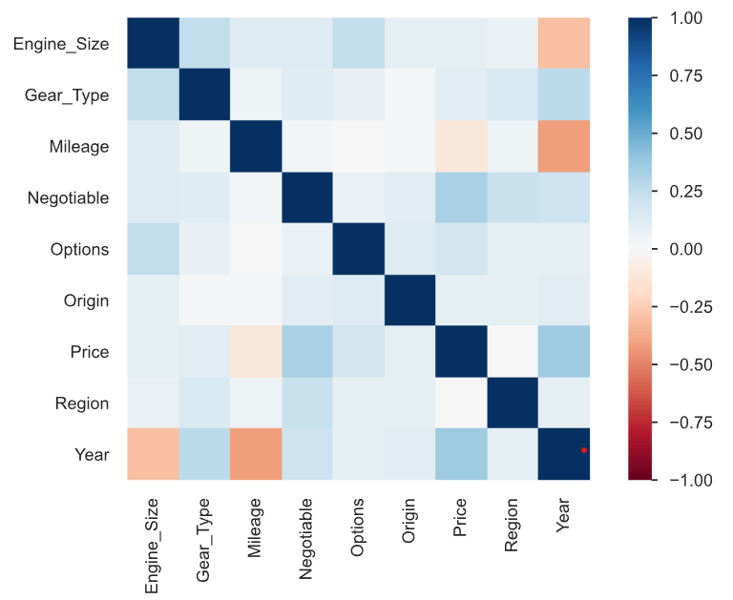
most significantly influence the price of a used car

Slide 7
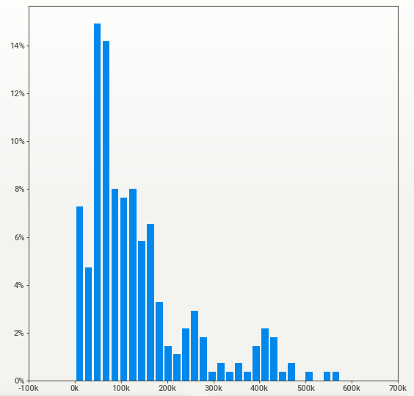
Range Price for Cars four years Old

Slide 8
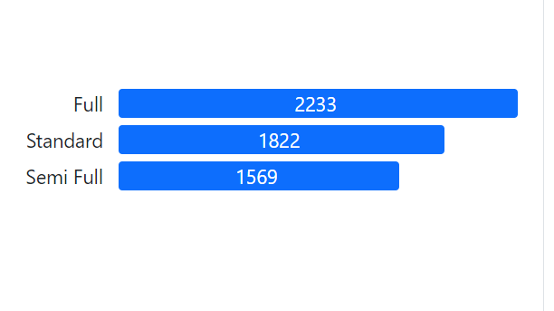
Cars options

Slide 9
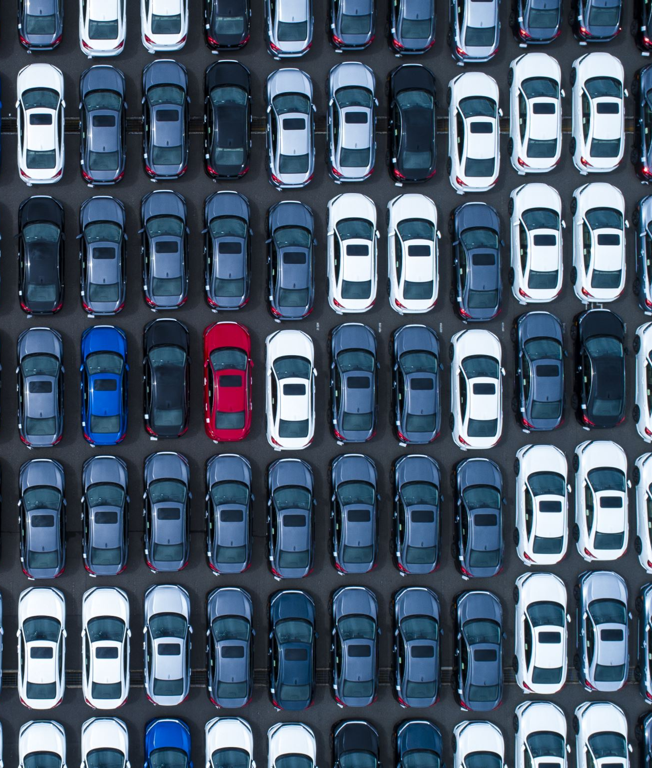
Conclusion
Riyadh have the most Cars used
Most common brand in Saudi Arabia is Toytoa

